Slide 1
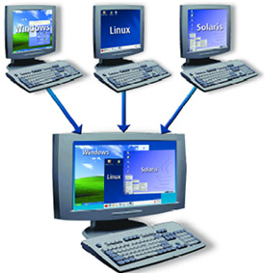
Docker Compose
Docente: Dott. Daniele Gobbo Modulo 1

Slide 2
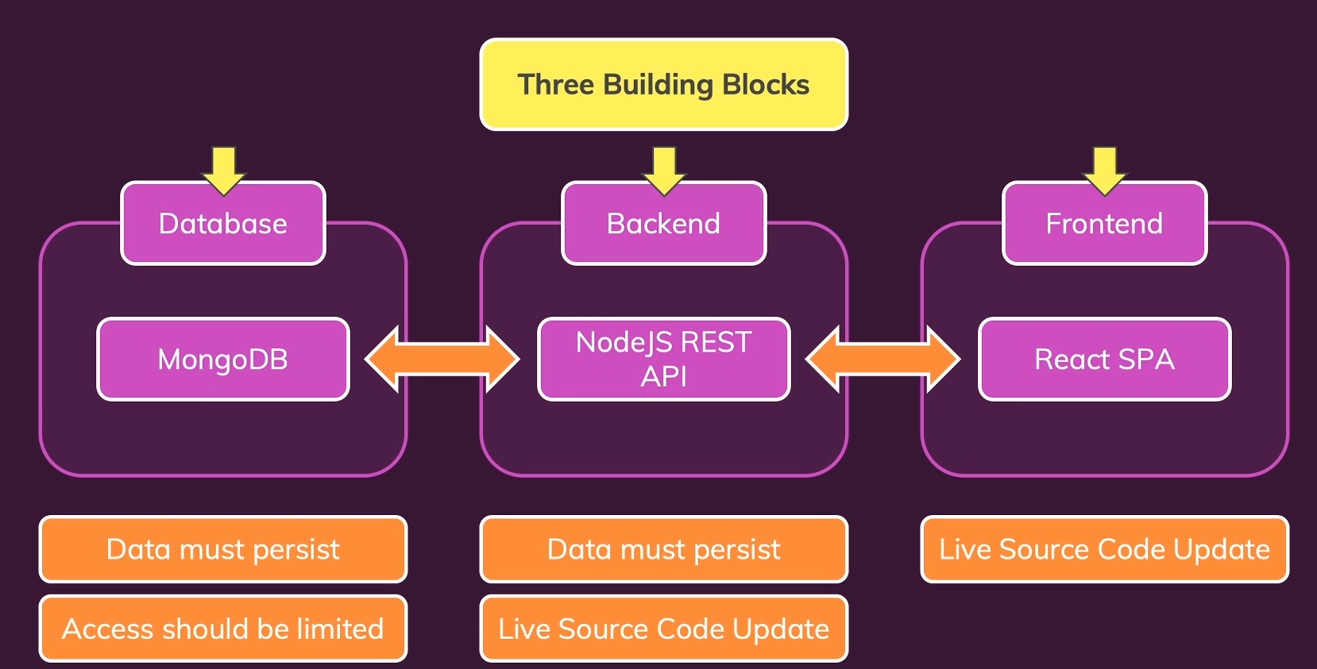
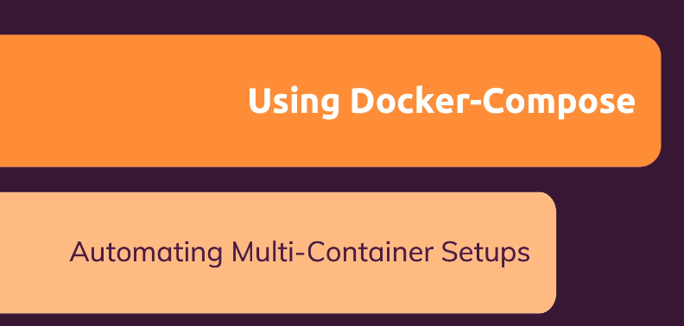
DOCKER COMPOSE
We need to create a network
we combined multiple containers
to build one application consisting of a backend, which was a Node express API,
a frontend, which was a React single page application and a Mongo Db database.
We built this application by launching three containers:
one for the database,
one for the backend,
one for the front end.
We ensured that these containers could communicate with each other in different ways
and of course we also added extra features
like persistent data, live source code updates.
We need to start our Mongo Db container
There is a lot of work to be done here and this is just a basic application consisting of three different containers that work together.
we add environmental variable
we add volumes
SOLUTION: Docker Compose:
which makes managing multi containers setups easier, it helps you automate the setup process and it allows you to bring up this entire setup, with all the different containers and their individual configurations with just one command.
And you can then also tear everything down
with just one command.
we attach volume to the network
Build our node API image
Build react single application image
Start react container
Bind Mount
Publishing ports

Slide 3
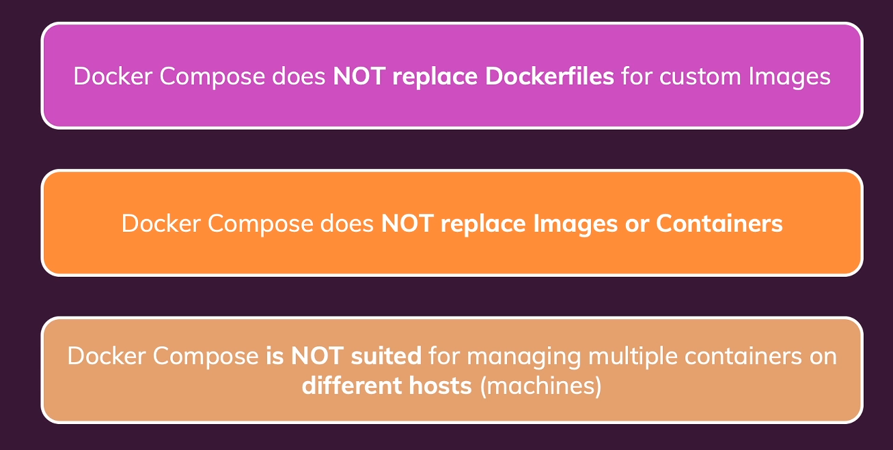
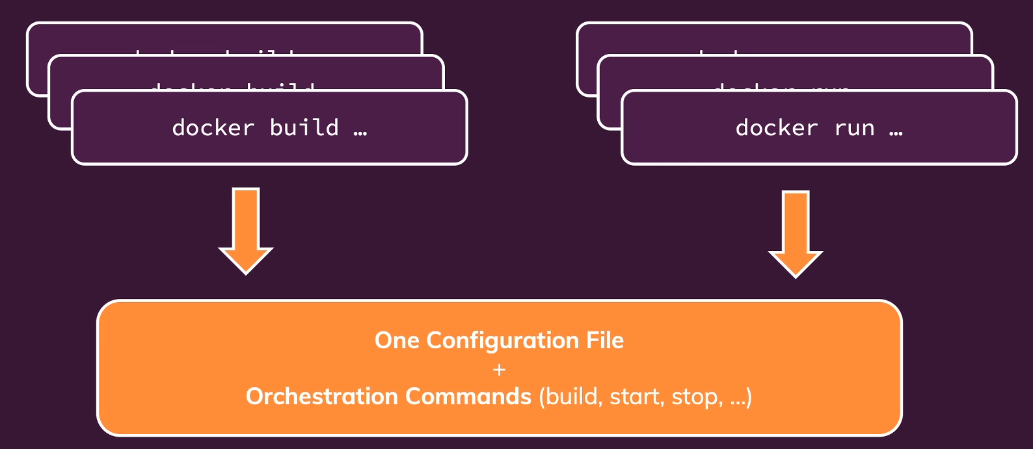
DOCKER COMPOSE: WHAT & WHY?

Slide 4
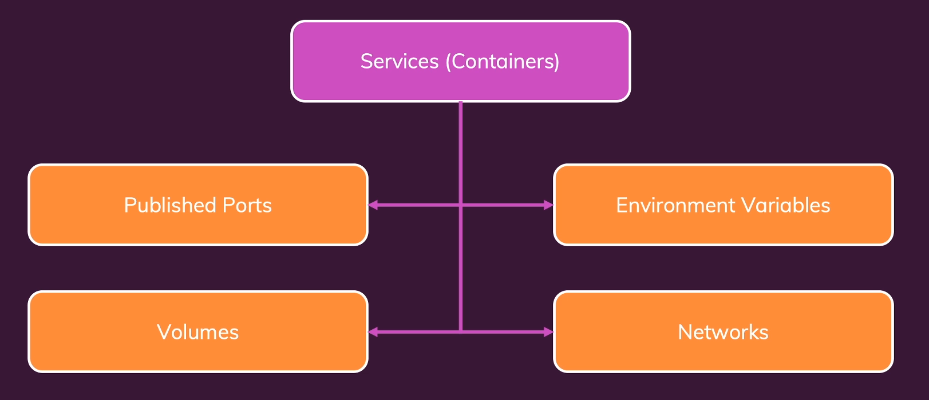
WRITING DOCKER COMPOSE FILE
Inside Docker compose file you can do basically everything you can do with Docker command in the terminal mode
Let's get started and let's simply work on that project we built in the last module and let's use compose instead of running all these individual commands.

Slide 5
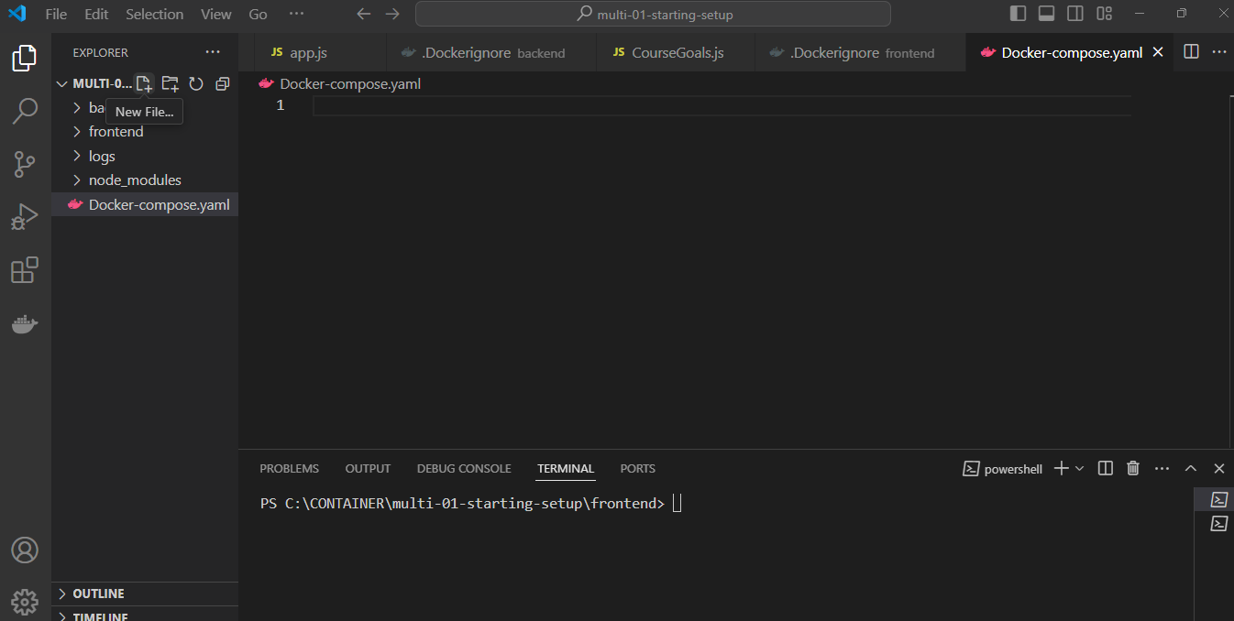
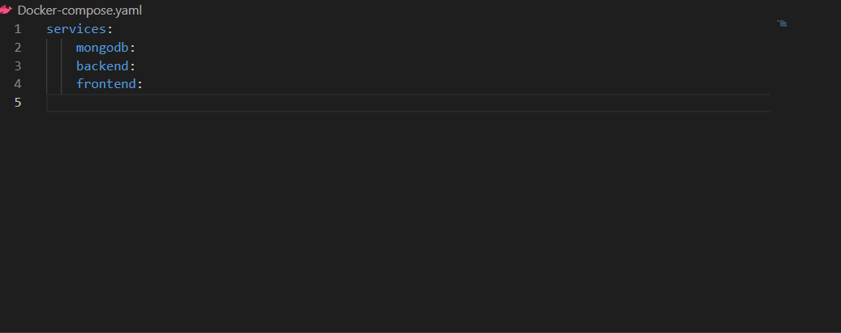
CREATING A COMPOSE FILE
Services contain CONTAINERS (TWO TAB KEY means that mongodb,backend and frontend are child of SERVICES
yamol is a specific text format where you use indentation to express dependencies between configuration options.

Slide 6
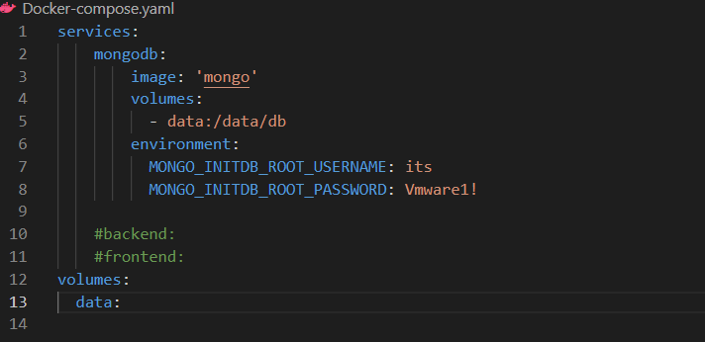
DIVING INTO COMPOSE FILE CONFIGURATION

Slide 7
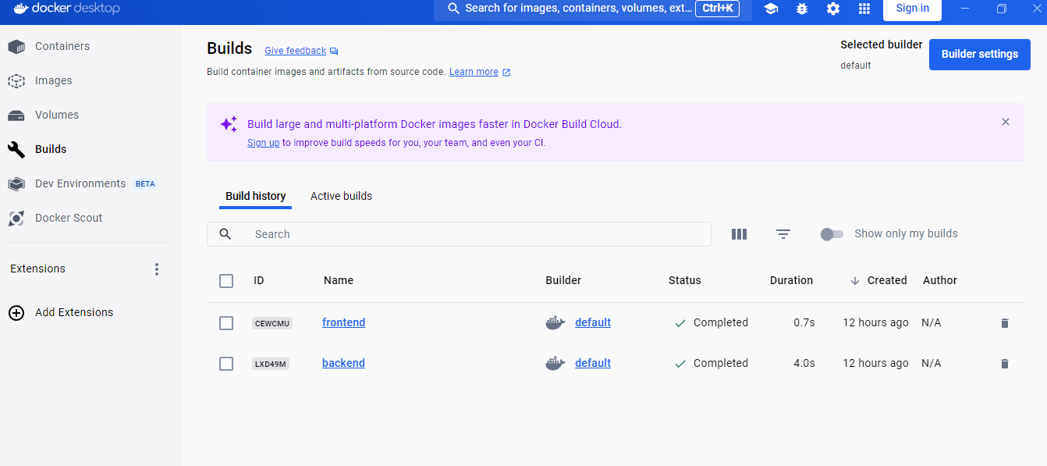
REMOVING ALL CONTAINER AND ALL VOLUME

Slide 8
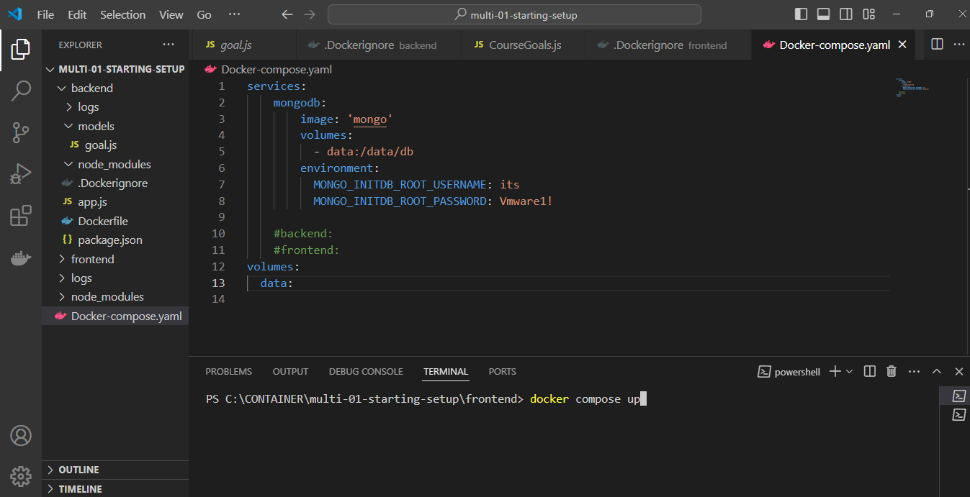
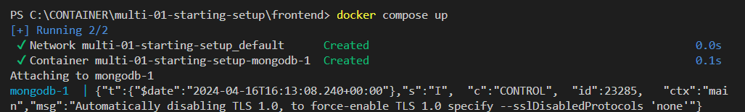
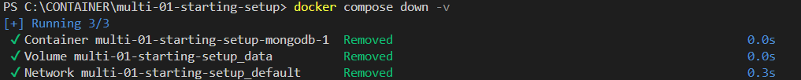
DOCKER COMPOSE Up & Down
Let’s move on on the backend….

Slide 9
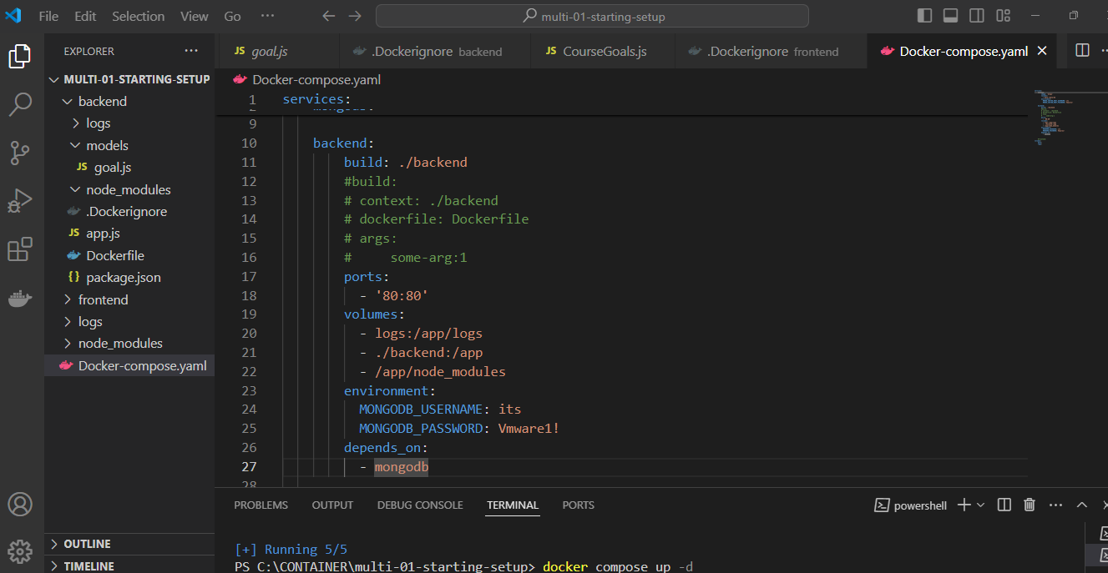
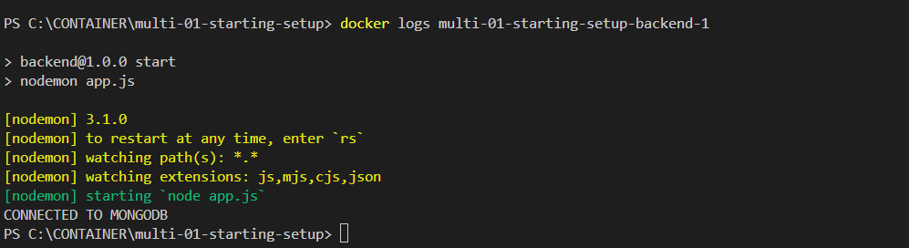
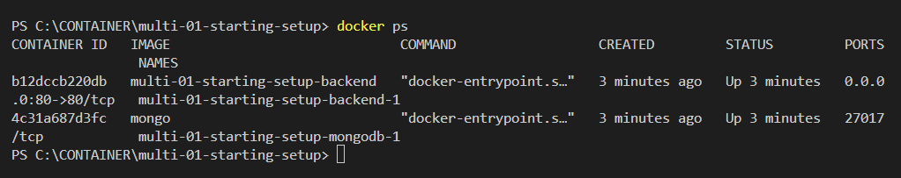
WORKING WITH MULTIPLE CONTAINERS
Let’s move on on the frontend….

Slide 10
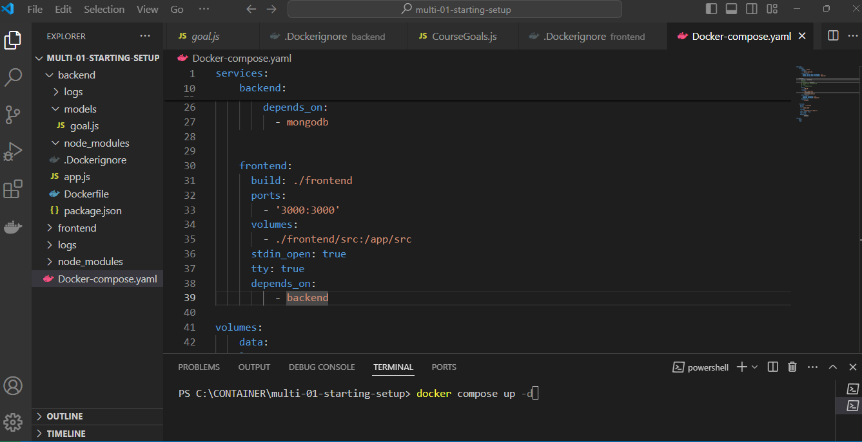
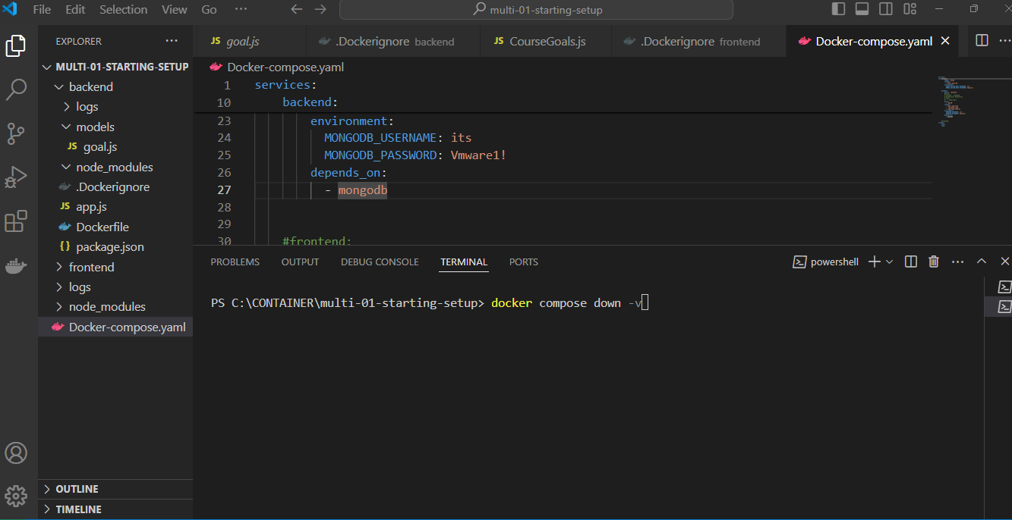
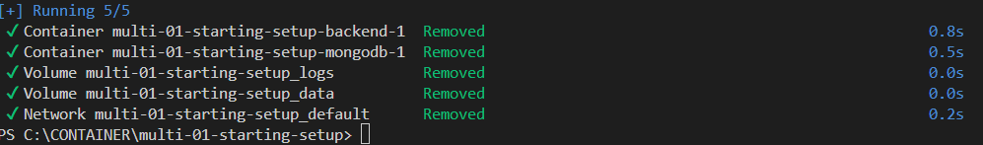
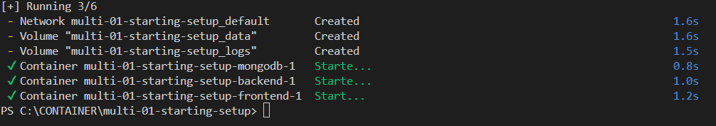
ADDING ANOTHER CONTAINER

Slide 11
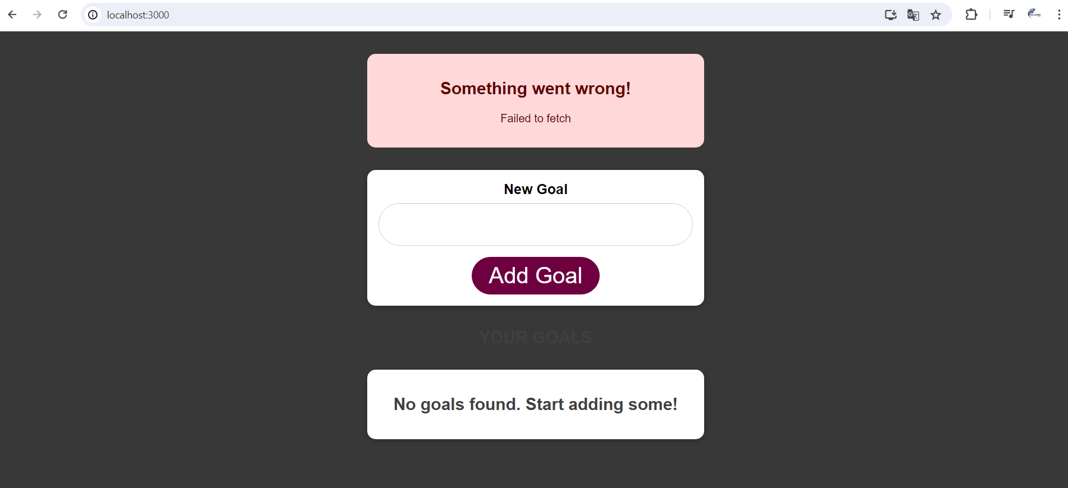


ADDING ANOTHER CONTAINER
ALT+96

Slide 12
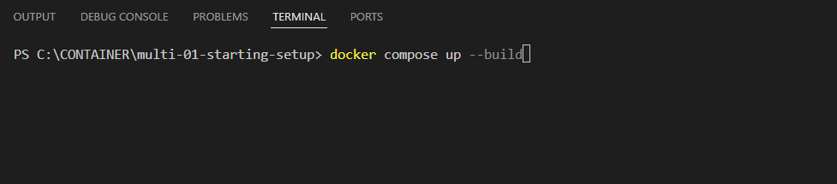

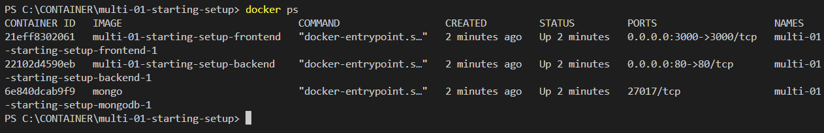
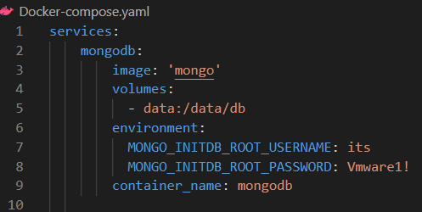
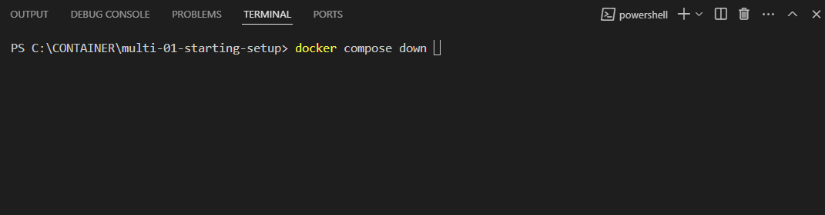

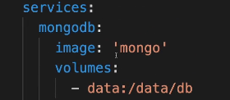
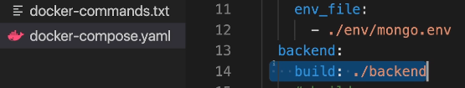
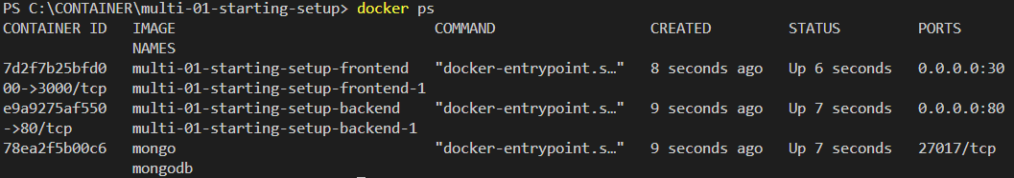
BUILDING IMAGES & UNDERSTANDING CONTAINER NAMES
You will notice, that these are not the names we defined in docker-compose.
There I specified mongoDb and backend and frontend as names.
Well, technically these are just the service names
and they are translated to containers, but these are not the container names.
BUT, if you want assign your own container name…..
FORCE THE REBUILD OF ANY CUSTOM IMAGE ON DOCKER COMPOSE FILE
build any missing images and then not start containers.
Just build the images

Slide 13
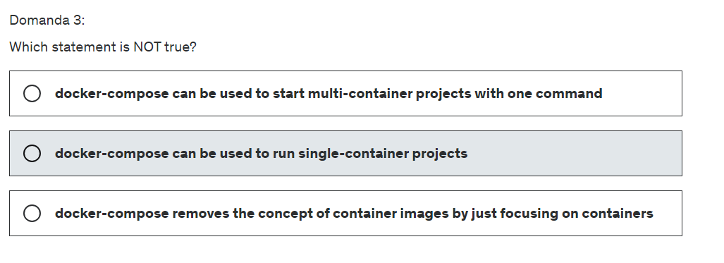
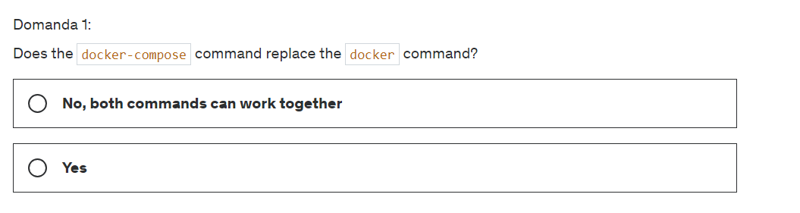
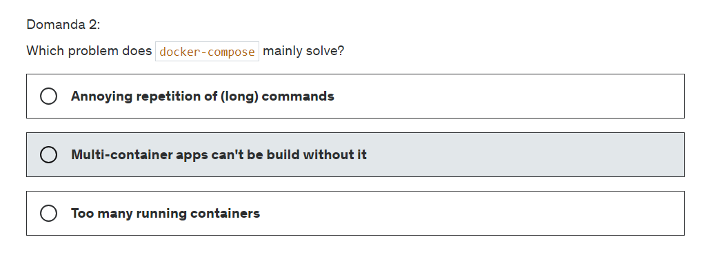
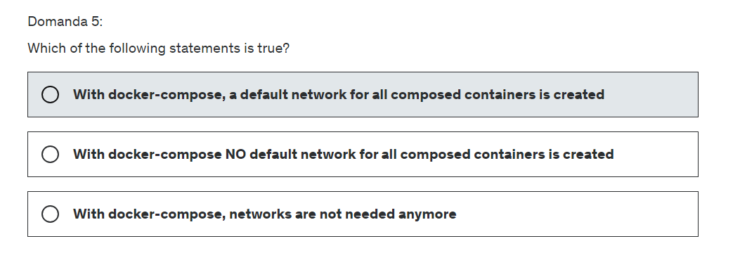
QUIZ TIME

